Slide 1
Ansible and z/OS
Luisa Martinez - Digital Acceleration Team martinel@us.ibm.com

Slide 2
What is Ansible
Ansible is an open-source, IT automation engine
configuration management
application deployment
task automation
Integrate z/OS into an enterprise automation strategy in a consistent way

Slide 3
Ansible Terminology
Control Node – a control node is any machine with Ansible installed
Managed Node - target node, or host, and that is managed by Ansible
Inventory - where you define the host you want to manage
Module - the units of code Ansible executes. Each module has a particular use
Collection - modules are grouped in collections
Playbook - Ordered lists of tasks, saved so you can run those tasks in that order repeatedly. Tells Ansible what to execute.

Slide 4

Ansible and z/OS
Control Node
Managed Node
z/OS LPAR
SSH
USS

Slide 5
Requirements – z/OS Managed Node
Unix System Services (USS) - environment configured on z/OS
OpenSSH - configured on USS environment
IBM Open Enterprise Python for z/OS - version 2.8 or greater
IBM Z Open Automation Utilities (ZOAU) – version 1.1 or greater
Bash – not required but helpful

Slide 6
Red Hat Ansible Certified Content for IBM Z
z/OS Core collection
z/OS CICS collection
z/OS IMS collection
Z HMC
z/OS System Automation collection
z/OSMF collection
Note: updates are being done on a regular basis
Notes:
BA Cognos 10 Template
1/12/2022
Presenter name here.ppt
6

Slide 7





RED HAT ANSIBLE ENGINE
Playbooks
SSH
REST
Inventory
ZOAU
RSA
#!/bin/bash
z/OS
Unix System Services
Unix Files
Datasets
TSO Environment
MVS Programs
JES Environment
z/OSMF

Slide 8
What is ZOAU - Z Open Automation Utilities
ZOAU complements z/OS UNIX (USS) to expose z/OS commands and resources in a consistent way that enables native z/OS automation through common interfaces
ZOAU brings USS closer to 3270 capabilities by providing a bridge to MVS environments:
z/OS data set interface
z/OS jobs interface
Operator interface
Access to MVS programs

Slide 9
z/OS Developer
Ansible
Python
Shell
*Other Languages
ISPF
TSO
ZOAU
USS
MVS
z/OS
IBM Z | © 2020 IBM Corporation

Slide 10

What about other Tools…
Ansible can be integrated with other
tooling:
z/OSMF
System Automation
Cloud Broker
Zowe
Jenkins
GitHub

Slide 11
What others are doing with Ansible + Python
Automating product installation and upgrades
Installation verification
Demonstrating audit compliance
LPAR migration
Automating manual tedious processes

Slide 12
Resources
Ansible for z/OS Overview
Ansible Galaxy
Ansible Certified Content for IBM Z
z Ansible Collections Sample Playbooks
ZOAU Documentation
ZOAU Python API

Slide 13
Learn
Try
Collections
Community
Documentation Site
IBM Ansible Content Solutions
IBM Ansible Z Trial
Red Hat Ansible Automation Platform Free Trial
IBM Sample Playbook Repository
IBM z/OS Core
IBM Z IMS
IBM Z System Automation
IBM Z Hardware Management Console
IBM Z CICS
Ansible for IBM Z Community
Ansible Twitter
13

Slide 14
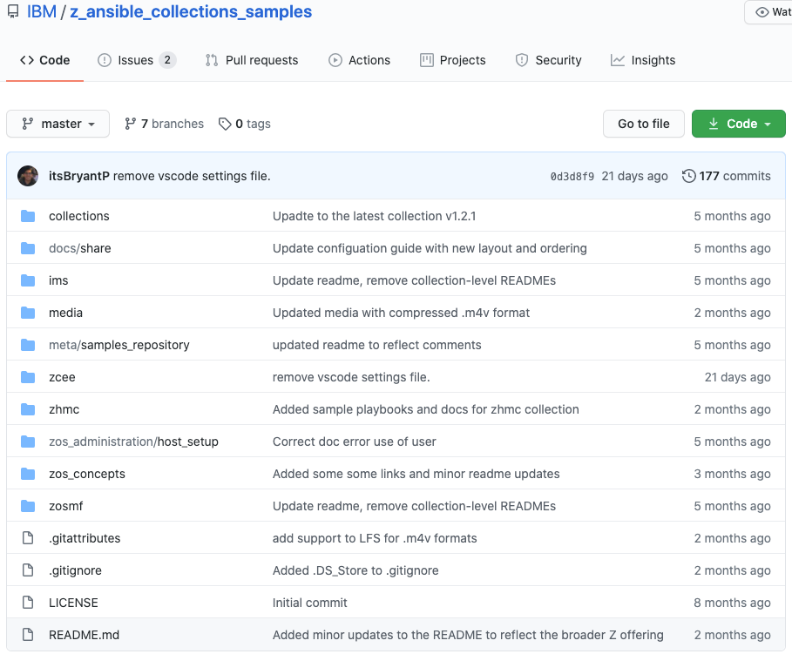
Begin with the Ansible® for IBM Z sample playbook repository
Prewritten playbooks spanning multiple use-cases and technologies
Access here

Slide 15

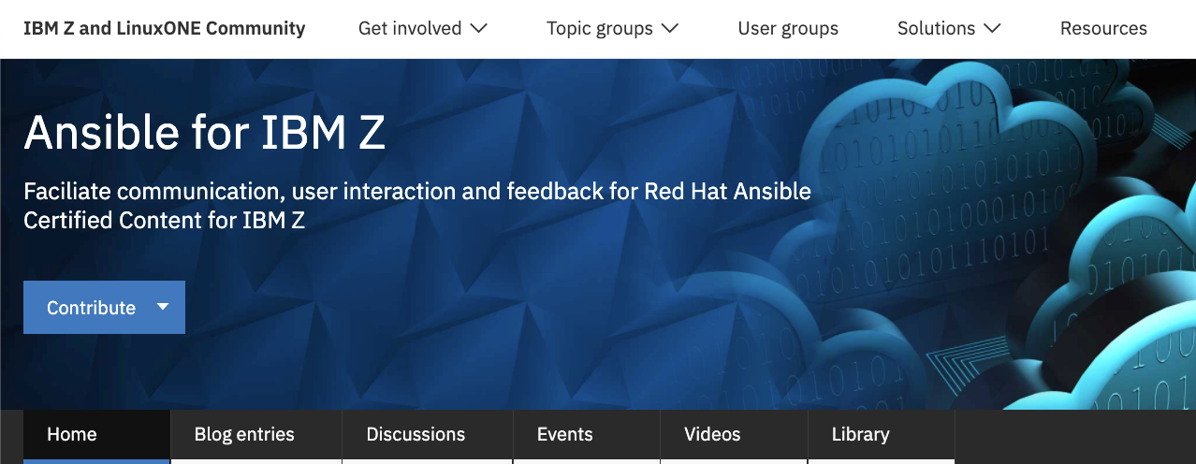
Join the community
Ansible® for IBM Z:
IBM Z & LinuxONE Community

